Slide 1

Brain Tumor Prediction.
Under the guidelines:
HEMANT sir. &
Sowmya mam.
Presented by:
Sachin T.P
Department of Computer Science and Engineering.
G.Madegowda Institute of Technology

Slide 2
Introduction:
The brain is the most important organ in the human body, responsible for controlling and regulating all critical life functions for the body and a tumor is a mass of tissue formed by the accumulation of abnormal cells, which keep on growing. A brain tumor is a tumor which is either formed in the brain or has migrated No primary cause has been identified for the formation of tumors in the brain till date.
We have proposed a computer-assisted radiology system which will assess brain tumors from MRI scans for the management of brain tumor diagnosis. In this study, we have implemented a model that segments images and classifies the tumors using CNN algorithm with a high degree of accuracy.

Slide 3
Our study deals with automated brain tumor detection and classiﬁcation.
Problem Deﬁnition:
Normally the anatomy of the brain is analyzed by MRI scans or CT scans.
Our system aims to detect the tumor from the given MRI scan and then classiﬁes the tumor as malignant or benign.

Slide 4
Our aim is to develop an automated system for enhancement, segmentation and classiﬁcation of brain tumors.
Scope:
The system can be used by neurosurgeons and healthcare specialists.
The system incorporates image processing, pattern analysis, and computer vision techniques and is expected to improve the sensitivity and eﬃciency of brain tumor screening.

Slide 5
Requirements:
Hardware Requirements:
Software Requirements:
Processor: Any Intel or AMD x86-64 processor
Python IDLE
Operating System: Windows 10
RAM: 4 GB
Disk Space: 8 GB
Graphics: Hardware accelerated graphics card supporting OpenGL 3.3 with 1GB GPU memory

Slide 6
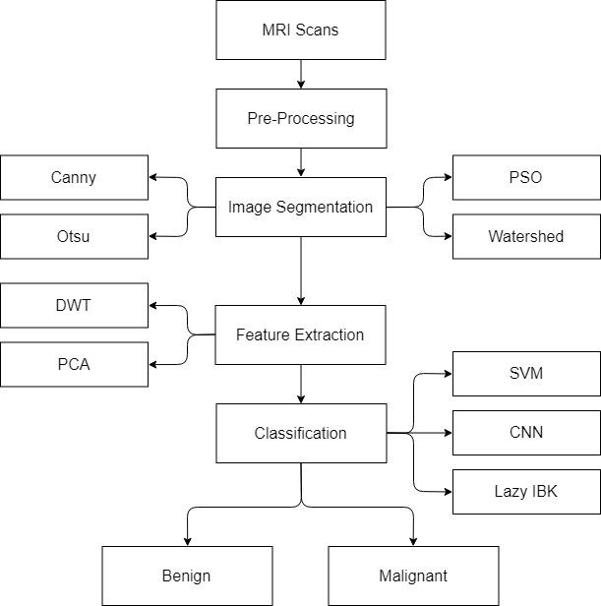
Software Architecture Diagram:

Slide 7
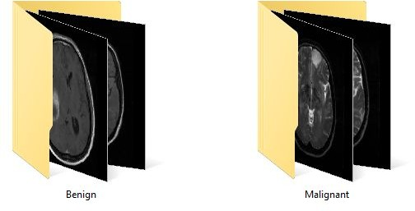
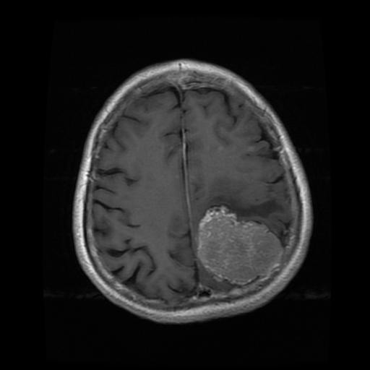
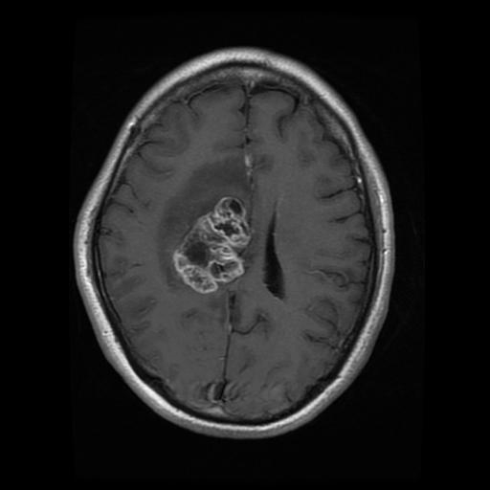
MRI Scans:
MRI scans of brain are taken as the input for all training and testing purposes.
The images are Grayscale and are resized to 256x256 px for processing.
Segregated Dataset
It is assumed that all the images given input to the system are either Benign (Non-cancerous) or Malignant (Cancerous).
The images are separated into two labeled folders for training and testing purpose only.
Sample MRI Scans

Slide 8
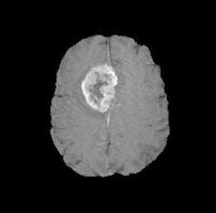
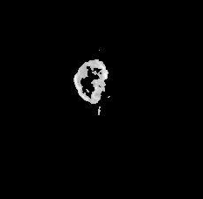
Segmentation:
Segmentation is the most crucial step in identification of Tumor.
This step extracts the tumor from the MRI scans which is then sent for extracting features.
Original MRI Scan
Segmented Tumor Image

Slide 9
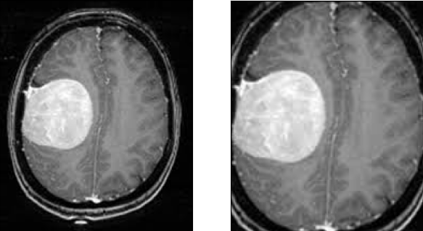
Pre-processing:
Median filtering is a common image enhancement technique for removing salt and pepper noise.
Weighted median filtering technique gives better results compared to median filter, adaptive filter and spatial filter.
Gaussian filter is also used to smooth the image and get rid of noise.
Before Pre-processing with Noise
After Pre-processing without Noise
The MRI scanning machines are very precise with almost no noise in the images.

Slide 10
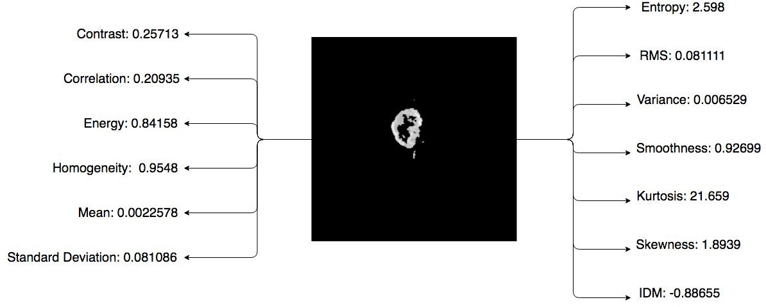
Feature Extraction:

Slide 11
Classiﬁcation:
Classification:
This requires the system to train using classified MRI scans and then based on trained data classify the test images.
This step classifies the Brain Tumor MRI scan as:
Benign
Benign (Non-Cancerous)
Malignant (Cancerous)
Following are the classification algorithm that have been implemented:
Convolutional Neural Network (CNN)

Slide 12
Classiﬁcation:
Convolutional Neural Networks (CNNs) are similar to traditional neural networks, where the input is a vector, here the input is a
multi-channeled image.
Convolutional Neural Networks (CNN)
It uses a neural network generated from the segmented images of training data to classify the tumor.
The training can take minutes and even hours based on the volume of training data.

Slide 13
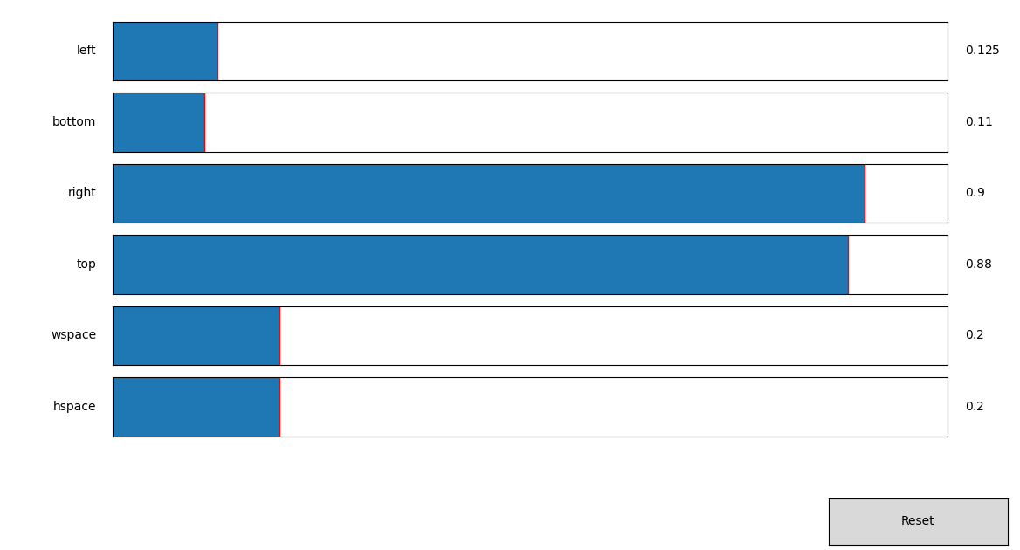
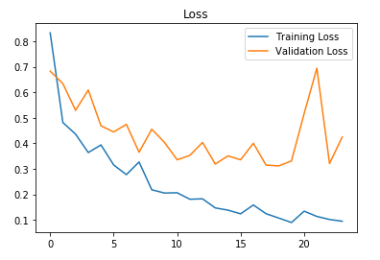
Results:
Integration Testing Accuracy

Slide 14
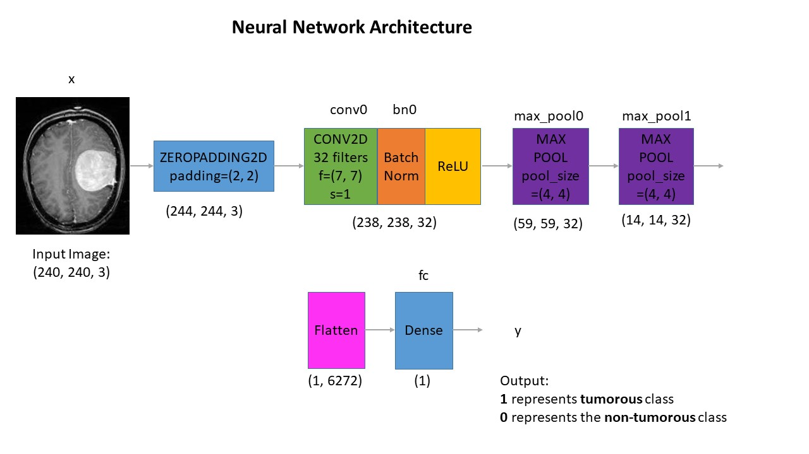

Slide 15
Conclusion:
In this study, using MR images of the brain, we segmented brain tissues into normal tissues such as white matter, gray matter, and tumor-infected tissues.
We used CNNs to segment the images and support vector machine to classify the tumor stage by analyzing feature vectors and area of the tumor.
In this study, we investigated texture based and histogram based features with a commonly recognized classifier for the classification of brain tumor from MR brain images.

Slide 16
Thank You

